Slide 1
Key principals and planning (plan, design, adapt, review) of exercise prescription for medical conditions (general).
Exercise Prescription for Special Populations
UZYKG9-15-3
Presentation by
Dr Rob Grieve

Slide 2
Aims/Objectives
The aims of this session are:
To review the application of knowledge and understanding of the benefits of exercise and physical activity applied to special population groups.
To apply the principles of planning and designing exercise progammes for special populations.
To provide an overview of the main stages in designing and developing an exercise programme.

Slide 3
Main stages in designing and developing an exercise programme.
We will review the following:
Pre Exercise Screening & Risk Stratification (related to ACSM, guidelines)
Goal Setting (Individualised & Condition Specific)
Exercise Prescription (FITT VP Model) (ACSM Specific)
Monitoring, Dosage, Adherence, Safety & Symptom Management
Behaviour Change & Education
Follow Up, Review & Progression

Slide 4
Module Learning Outcomes/Goals
COURSE 2:Benefits, Prescription and Application of Exercise and Physical Activity to Special Populations.
Apply the underpinning knowledge required to plan, design, adapt and review a scientific exercise prescription for selected controlled medical conditions.
Demonstrate a critical awareness of the dose response issues related to exercise prescription in selected controlled medical conditions.
Course Content
Application of knowledge and understanding of the benefits of exercise and physical activity applied to special population groups.
Principles of planning and designing exercise progammes for special populations – things to consider.
How exercise programmes can be adapted.
Evidence review of adaption of exercise for special population groups.

Slide 5
This module is made up of two courses…although closely linked!
Progression from Foundations of Exercise Prescription.
Important to review the previous material covered and build on it in this module.
COURSE 1
Assessment and Clinical Reasoning Underpinning Exercise in Special Populations.
COURSE 2
Benefits, Prescription and Application of Exercise and Physical Activity to Special Populations.

Slide 6
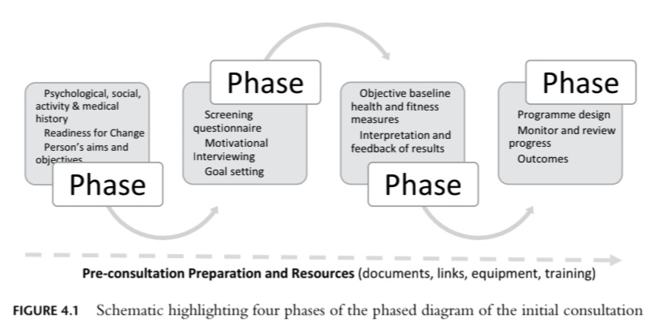
Initial Consultation
Swainson, Rutherford, Buckley (2022).

Slide 7
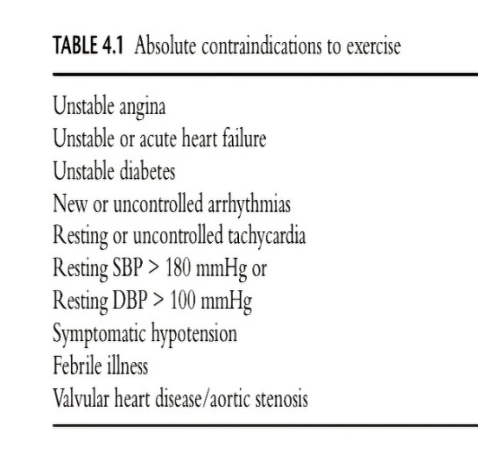
Pre Exercise Screening & Risk Stratification (related to ACSM, guidelines)
Take a medical history, including medications and any medical/musculoskeletal issues.
Before referral into an ERS, persons should have been examined by the referring medical/HCP and deemed safe to exercise. Normally a referral form is also sent.
It is essential to check for any absolute contraindications to exercise and in the event of one or more of these being present, the referred person must be referred back to their referring HCP.
The standard screening questionnaire used in practice is the Physical Activity Readiness Questionnaire (PAR-Q).

Slide 8
Medical Conditions and Inclusion Criteria
Medical condition | Specific Inclusion Criterion
Obesity | With or without additional CHD risk factors
Osteoarthritis (OA) | Mild to moderate severity (as determined by the referring medical/health professional
Joint replacement | At least 3 month post op
Osteoporosis | Diagnosed, treated and stable. Pre or post-fracture dependent on the discretion of the referring medical/ health professional
Simple mechanical Back Pain | In the absence of red flags
Asthma | Stable and controlled. The client must bring and keep their reliever with them
COPD | Mild to moderate severity; at the discression of the referring medical professional, preferably as part of a structured clinical intervention
Stress | GP’s provision as to the patients suitability for referral
Anxiety | Mild to moderate severity (HAD score between 8-14)
Depression | Mild to moderate
Diabetes Mellitus Type 1 | Stable and controlled: GP or referring clinician to advise on modification of insulin prior to exercise or physical activity
Diabetes Mellitus Type 2 | Diet controlled or orally medicated. GP or referring clinician to advise on modification of insulin prior to exercise or physical activity
Hypercholesterolemia | Diagnosed and stable
Hypertension | Diagnosed and stable (<180/100 mmHg prior to referral: 2014)
CHD/Angina pectoris | Provision for relief medication must be addressed

Slide 9
Exclusion criteria | Red Flags
Any unstable medical condition | Non-mechanical pain
Resting BP >180/100 mm/HG | Thoracic pain
Previous Myocardial infarction(MI)? If not BACPR trained | Fever and unexplained weight loss
Active retinal haemorrhage | Bladder or bowel dysfunction
Any medical condition that you are not Qualified to deal with | Ill health or presence of other medical illness
 | HIV
 | Progressive neurological deficit
 | Disturbed gait or saddle anaesthesia (a loss of sensation restricted to the area of the buttocks and perineum)
Red Flags are internationally recognised as precluding a patient/client from exercising, as they indicate the likely need for higher level care/intervention

Slide 10
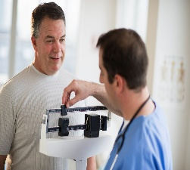
Pre Exercise Screening & Risk Stratification (related to ACSM, guidelines)
(In ERS/PARS)
Initial Session/Formal introduction and putting the client at ease.
Going through the PARQ form. https://eparmedx.com/resources/knowledge%e2%80%91mobilization/
This is the initial screening tool and provokes good conversation between client and instructor and allows both verbal and non-verbal communication.
You should ask a range of open and closed questions, shows empathy and sensitivity. Do not criticise, be a good listener, and reflect on the information given. This will improve mutual understanding, reduce tension and allow you to provide an appropriate response.
If the client answers no to all questions and the blood pressure is less than 140/90 and the heart rate is regular and under 100 beats per min, the risk of exercise is low.
(If yes to any Question then you must Risk stratify)
Notes:
You could get students to discuss what empathy means as a sport rehabilitator

Slide 12


Slide 13
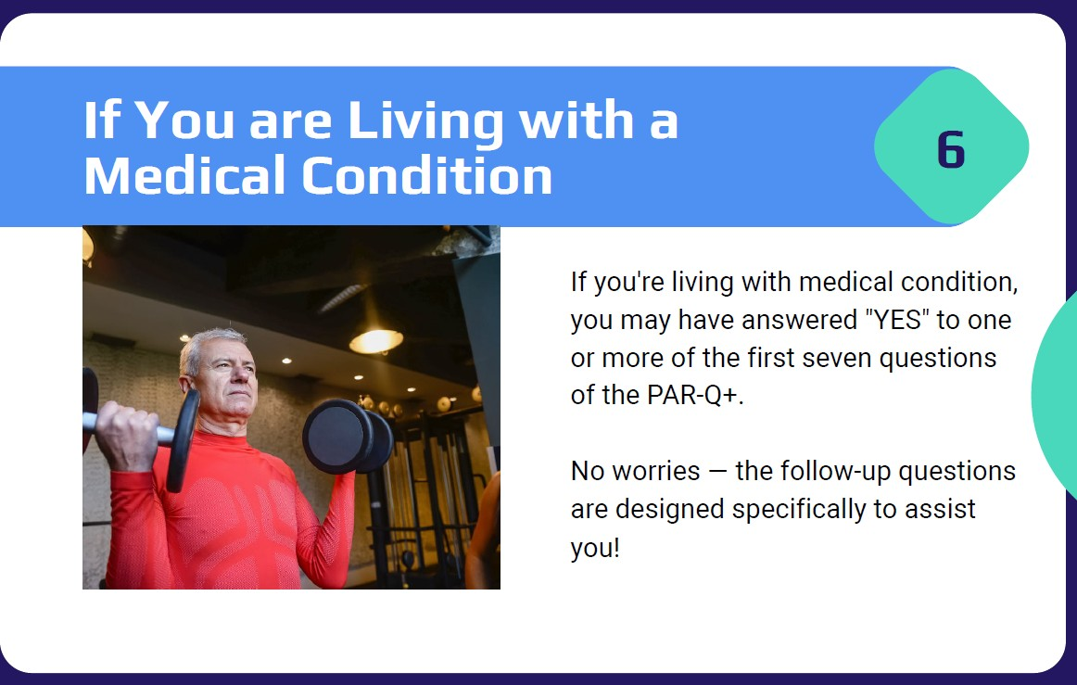

Slide 15
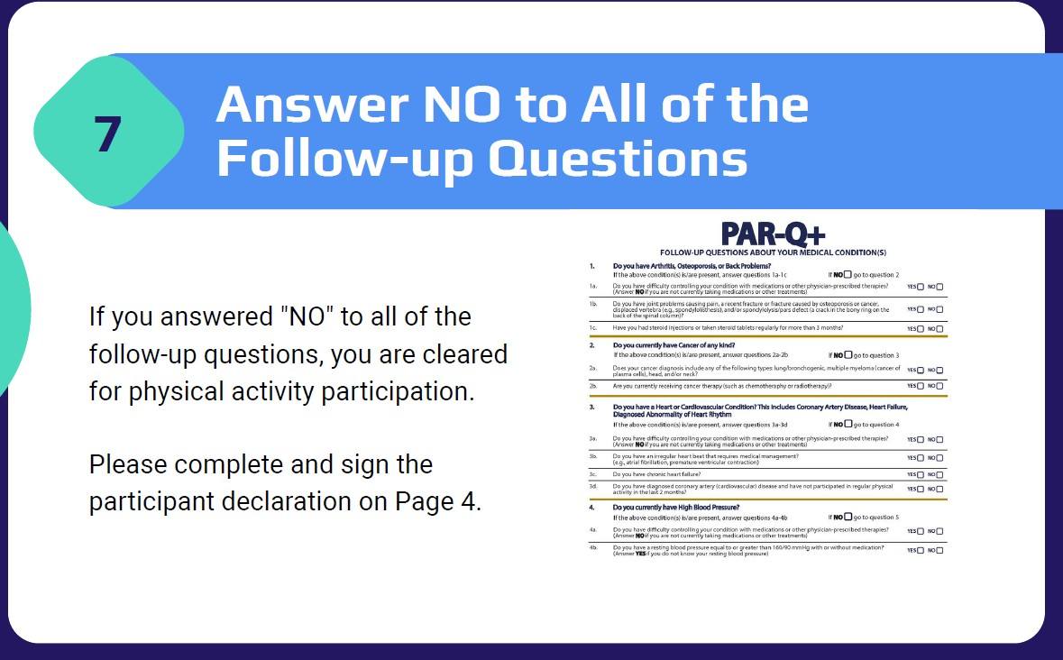

Slide 16
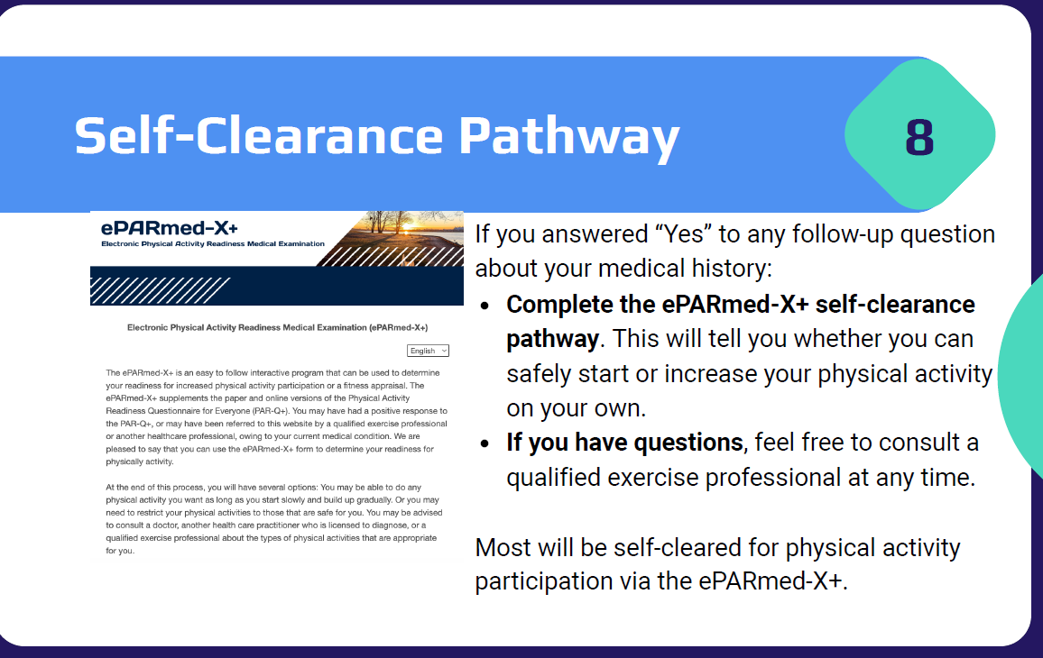

Slide 17

Risk stratification-Normally conducted if NO to PARQ Question/s
The Irwin and Morgan Risk Stratification Tool.
This uses a simple traffic light system whereby
Green = Low Risk
Amber = Medium risk
Red = High Risk
Low Risk Patients identified in this way should remain within the exercise referral service and may undertake a wide range of activities, programmed but not necessarily supervised by, the referral instructor.
Medium risk patients must be entered into an individualised, supervised exercise program relevant to their condition
Patients with cardiac disease, who are assessed as High risk by the Irwin and Morgan method, must be referred to the original health care professional for referral to a Phase 3 then on to Phase 4 Cardiac Rehabilitation Service. Where non cardiac patients are identified they must be referred to a multi-disciplinary team for further assessment before embarking on an exercise program.
(Professional and operational standards for exercise referral)

Slide 18
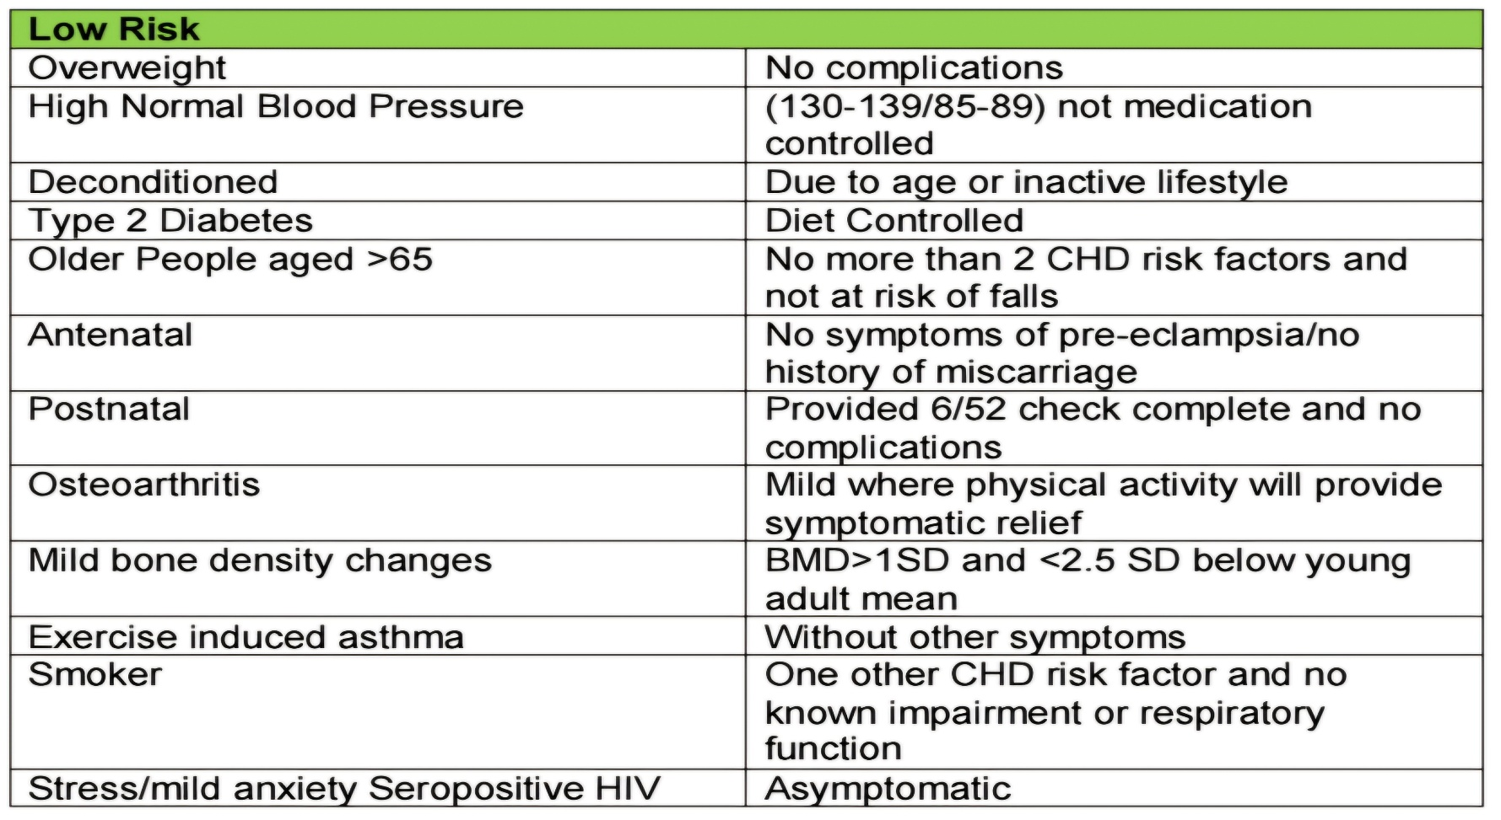

Slide 19
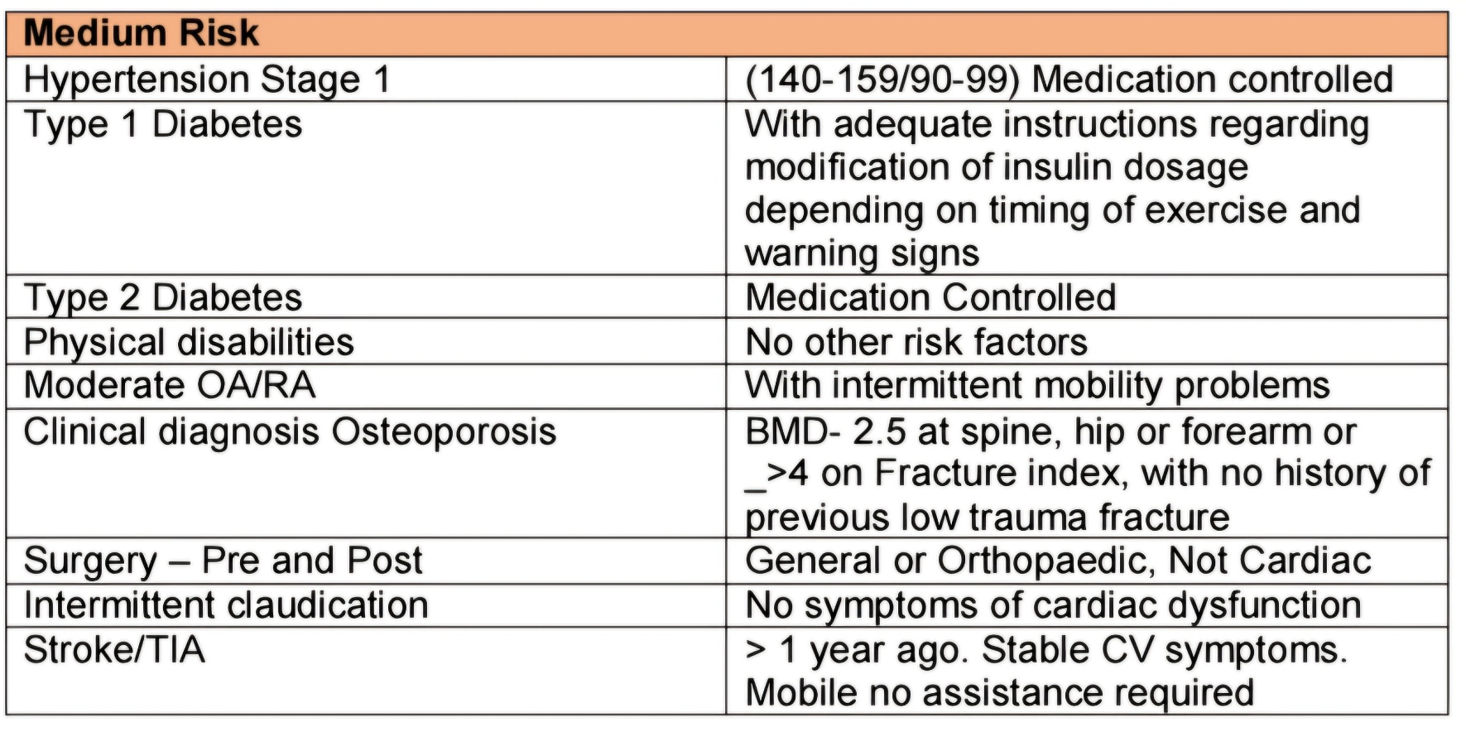

Slide 20
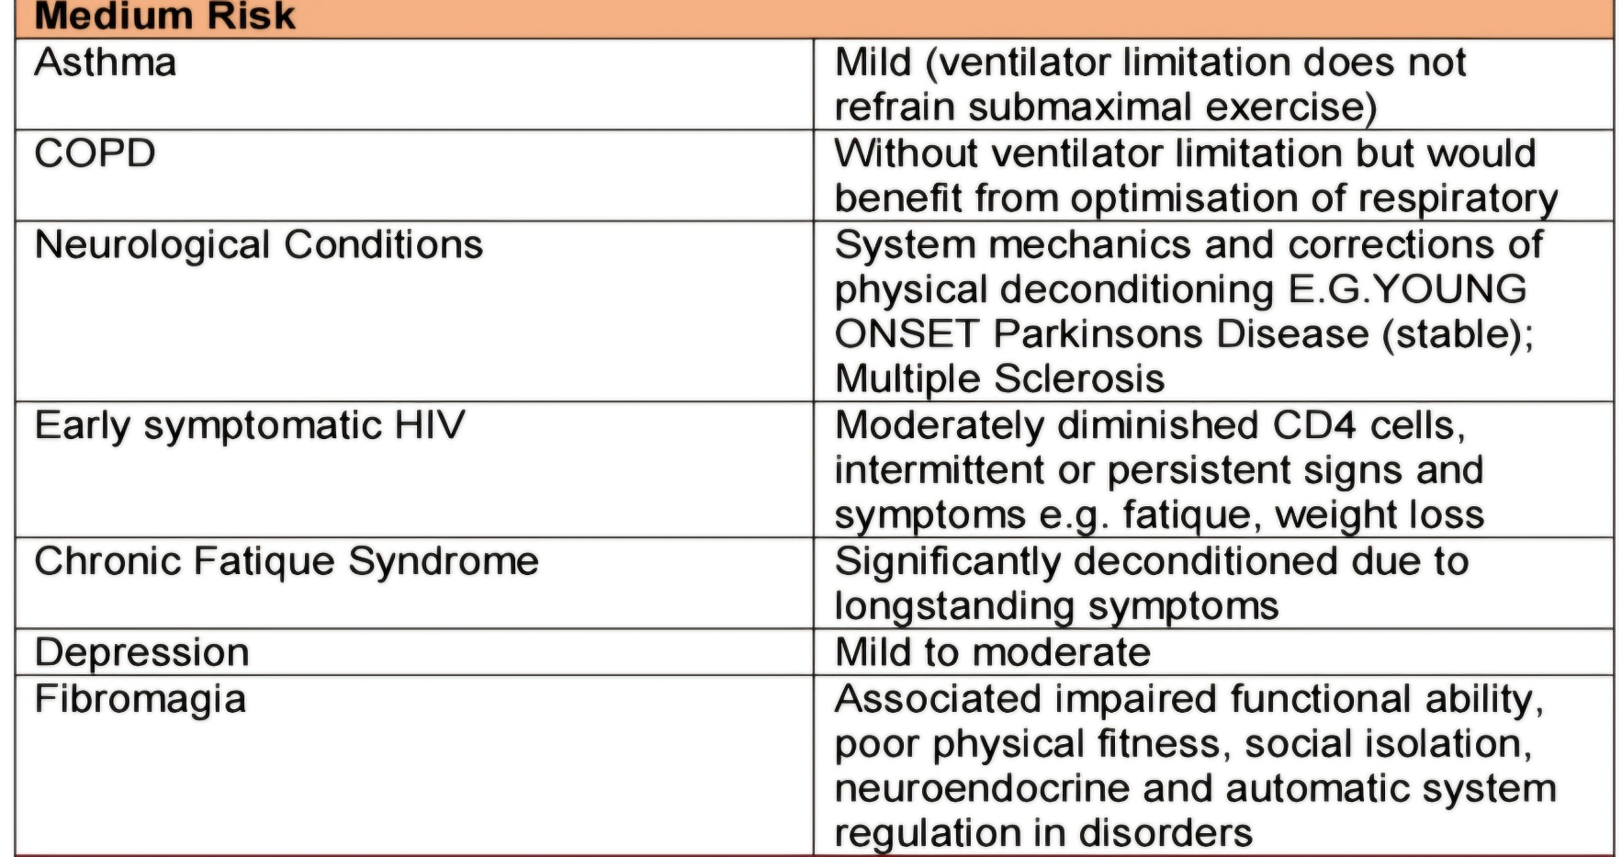

Slide 21
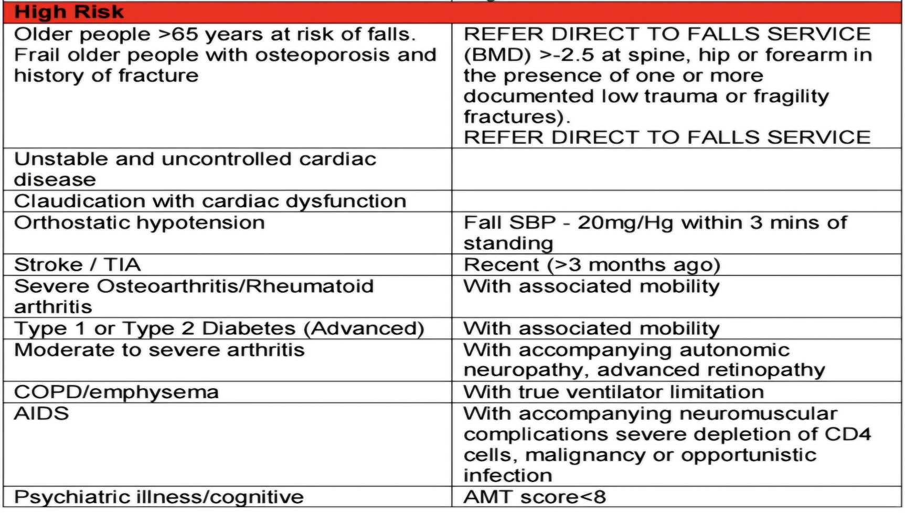

Slide 22
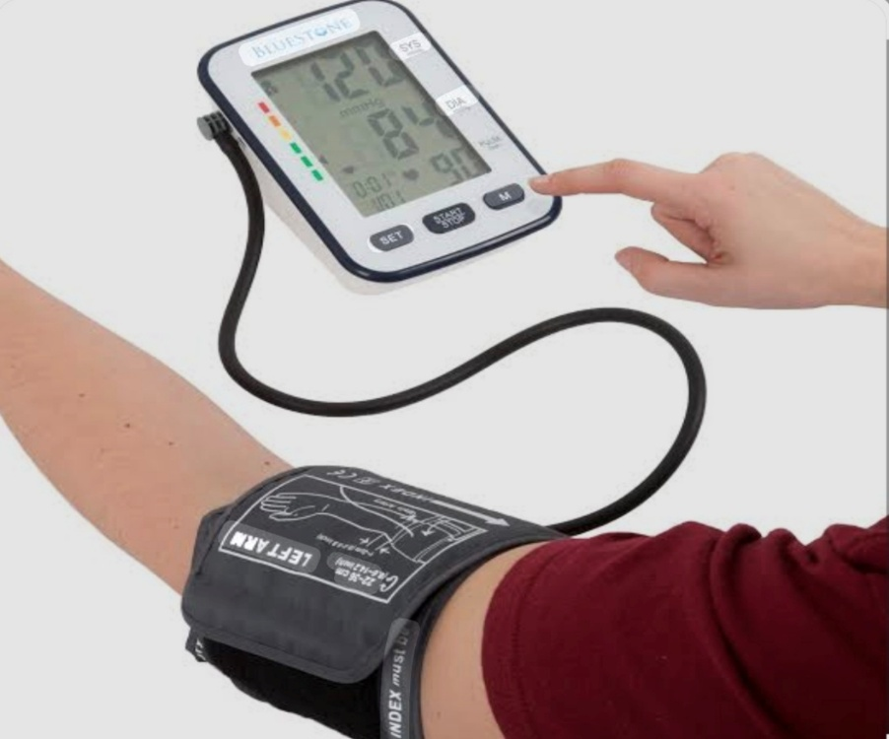
Resting baseline health measurement (Assessment)
These are included as part of the physiological/health performance tests.
The following resting measurements would be included:
Resting heart rate, blood pressure, height and weight.
These baseline measurements are an extension of the standard screening and questionnaire procedures.
These are measured to control for cardiovascular risk even if a person is not referred for a cardiovascular-related condition.
They are valuable markers to measure at baseline, midway through the programme and at the end to identify any changes/improvements.

Slide 23

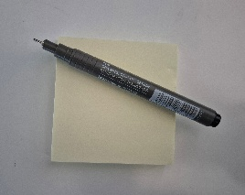
Group Activity
Why is Screening and taking physiological measurements (BP, HR) important before an exercise programme?
Work in pairs, put ideas on a post-it or interactive board and then share with the group.

Slide 24
SMARTS Goals (ACSM 2026)
Ideally identified by the individual based on their desired results (self determination).
………………
Goals should be……
Specific-precise and clear
Measurable-quantifiable
Action-orientated, should indicate what should be done
Realistic-achievable
Timely-have a specific/realistic time frame
Self-determined-should be determined primarily by the individual

Slide 25

Goal Setting (Individualised & Condition Specific)
ACSM-Theories of behaviour change
Goal Setting Theory
Four mechanisms play a role in behaviour change with goals:
Goals put your attention and energy toward behaviour that is desired.
Goals will lead to more effort.
Goals will extend the time and energy that is put into some behaviour that is desired.
Goals will increase goal relevant skill usage.

Slide 26
Examples of goals (ACSM, 2026)
“My goal is to swim 10 laps each Saturday for the next 3 months.”
“My goal is to walk on the treadmill for 20 min/per day for 3 days a week, for the next month.”
Task: Any thoughts how these goals relate to SMARTS?

Slide 27
Group Activity
Think of some SMARTS goals you could do with any of the three special populations?
Work in pairs, put ideas on a post-it or interactive board and then share with the group.

Slide 28

Special Considerations for Planning and Designing Exercise Programme
We will cover specific special considerations for each of the three special populations next week in the further planning and design sessions.

Slide 29
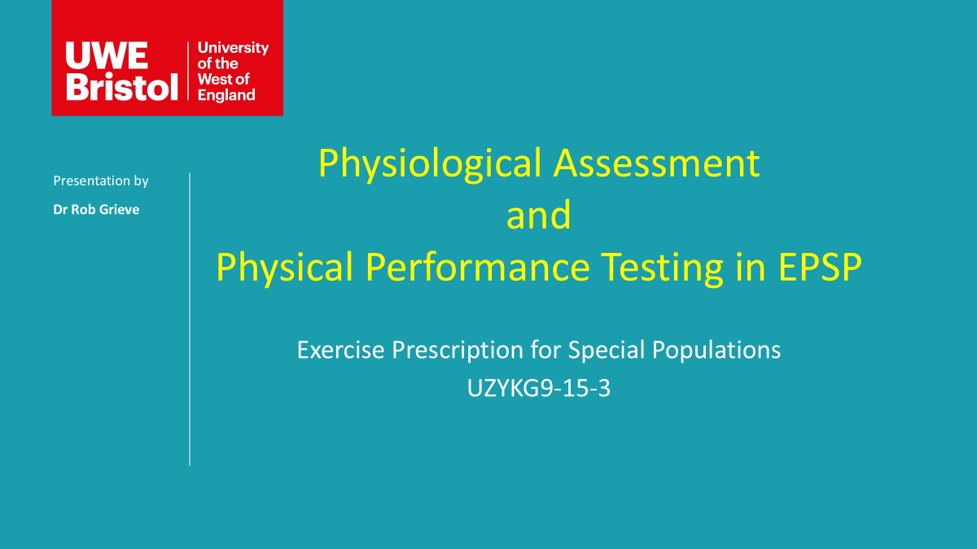
Exercise Testing/Performance testing
See lecture notes for Exercise Testing/Performance testing.

Slide 30
Exercise Prescription (FITT VP Model) (ACSM Specific)
Frequency: How often an exercise is performed (e.g., 3–5 days a week).
Intensity: How hard the exercise is, often measured by heart rate, % of 1RM (repetition maximum), or perceived exertion.
Time (Duration): The duration of each session (e.g., 30–60 minutes).
Type (Mode): Aerobic, resistance, lifestyle activity changes etc.
Volume: The total amount of energy expended, or work done (e.g., sets
reps, weight). Volume is a sum of the intensity, frequency, duration, and longevity of a physical activity program.
Progression: The systematic advancement of the program to increase intensity or volume over time. Beware of exercise progression and regression over the course of the exercise prescription/programme.

Slide 31

Components of the Exercise Training session (ACSM, 2026)
A single exercise training session is typically composed of the following phases:
Warm up
Conditioning
Cool-Down
Each exercise session should be designed with a training goal in mind and include a specific warm-up and a type of conditioning exercise (Mc Gowan et al., 2015).
Flexibility exercises may also be incorporated into the training session, either before or after the conditioning phase, and/or separately, in order to improve range of motion ROM) and enhance muscular coordination (Kruse and Scheuermann (2017).

Slide 32
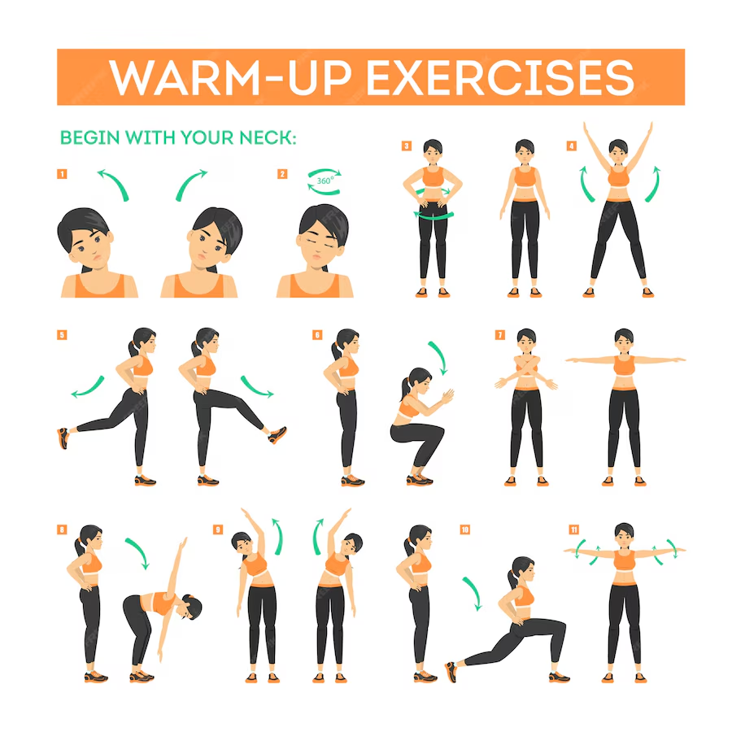
Warm up phase (ACSM 2026)
Is a transitional phase, allows the body to adjust to the changing physiological/biomechanical demands of the specific exercise session and should include light- to moderate-intensity activities specific to the muscle groups that will be employed during exercise (Mc Gowan et al., 2015)
Warming up improves ROM and may reduce the risk of injury during the exercise session (Garber et al., 2011).
A dynamic warm-up, involving large muscle groups ( walking,jogging, cycling), is superior to static flexibility exercises for the purpose of enhancing the performance of aerobic exercise, sports, or resistance exercise, especially activities that are of long duration or with many repetitions (Simic et al., 2013).
The specific time dedicated to a warm up may vary depending on the individual: evidence suggests this should be between 5 and 15 minutes (Mc Gowan et al., 2015)

Slide 33

Conditioning Phase (ACSM 2026)
(10-60 minutes)
During the conditioning phase, training exercises could include aerobic, "resistance, flexibility, and/or sports activities, depending on the specific goals al the exercise session. See specifics about these modes of exercise below.
Duration depends on the intensity and type of the activity.

Slide 34
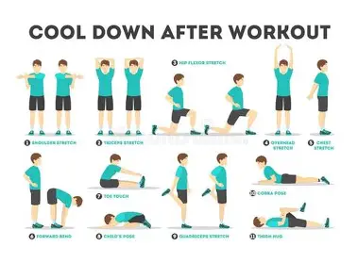
Cool-Down(ACSM, 2026)
Cool-downs are an integral part of an exercise session, evidence suggests that cool-downs have limited impact on improving the psychobiological markers of recovery (Van Hooren, et al., 2018).
Cool-downs may be useful to allow the body to return to near-resting levels (eg., volume of oxygen consumed per unit time VO2, heart rate [HR]after the exercise session.
Low to moderate-intensity flexibility exercises, such as static stretching, may also be performed to help facilitate a more relaxed physiologic state (Behm et al., 2019).

Slide 35
Group Activity
Work in your group and think of some Warm Up, Conditioning and Cool Down exercises?
Work in pairs, put ideas on a post-it or interactive board and then share with the group.

Slide 36
Cardiorespiratory/Aerobic Fitness (ACSM, 2026)
Cardiorespiratory fitness (CRF) reflects the functional capabilities of the heart, blood vessels, lungs, and skeletal muscles to transport and utilise oxygen to perform physical work (Ross et al., 2016).
An exercise prescription, featuring moderate- to vigorous-intensity continuous training consisting of large rhythmic movement for a sustained duration is the traditional method to improve CRF (Garber et al., 2011).
Evidence support interval training, in which moderate- to high-intensity efforts interspersed with brief periods of rest or low-intensity activity performed repetitively demonstrate similar improvements in CRF as observed in traditional endurance training, with a reduced total exercise volume and time commitment(Ito 2019).

Slide 37
Cardiorespiratory/Aerobic Fitness (Cont`d)
Improvements in CRF are primarily driven by intensity, frequency, and duration, all types or combinations of aerobic activities (e.g. walking, jogging, running, sprinting) can contribute toward meeting physical activity (PA) recommendations independent of improvements in CRF (Duran et al., 2023) and improving health outcomes especially true for individuals with lower CRF.
For the purpose of enhancing CRF an exercise prescription consisting solely of 150 min per week of moderate-intensity exercise may not be sufficient to improve CRF in a large portion of the population, thus requiring a marked increase in the dose-response exercise stimulus, specifically increases in intensity and/or duration (Ross et al., 2015).

Slide 38
Aerobic-Exercise Recommendations (ACSM, 2026)
FITT | Recommendation
Frequency | At least 3 days per week Spreading exercise sessions across 3-5 days per week. Most conducive strategy to reach the recommended amounts of PA.
Intensity | Moderate (40%-59% HRR) and/or vigorous (60%-89% HRR intensity is recommended for most adults.
Time | Most adults should accumulate 30-60 min per day (≥150 min per week up to 300 min per week) of moderate-intensity exercise, also 20-60 min per day (≥ 75 min and up to 150 min per week)- wk-1) of vigorous-intensity exercise, or a combination of moderate and vigorous-intensity exercise daily to attain the recommended targeted volumes and health-related benefits of exercise.
Type | Aerobic exercise performed in a continuous or intermittent manner that involves major muscle groups is recommended for most adults

Slide 39
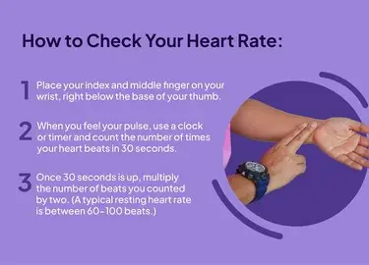
Intensity Measures-Exercise prescription
Aerobic- Calculating HRR
To calculate 60% HRR for a 65-year-old with a resting HR of 70 beats per minute, you must: 1. Calculate the maximum HR – estimated by [220 − age]: 220 − 65 = 155 bpm 2. Deduct the resting RHR: 155 − 70 = 85 (HRR) 3. Multiply HRR by 0.6: 85 × 0.6 = 51 4. Add the RHR back on: 51 + 70 = 121 beats per minute.
……………………………………………………………………………………..
Also can use 60%–85% Hrmax. OR Borg’s Ratings of Perceived Exertion 6–20 scale, OR 1–10 scale (e.g. when a person is taking beta-blocker medication).
Exercise prescription for resistance training can be based on the ten-repetition maximum or using pain scales for musculoskeletal conditions.

Slide 40
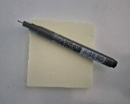
Group Activity
Work in your group and think of some Aerobic Exercises you could use for any special population. We will go into more detail on Monday.
Work in pairs, put ideas on a post-it or interactive board and then share with the group.

Slide 41
Resistance Training (RT) ACSM, 2026
Includes muscular strength, hypertrophy, power, and local endurance, is achieved through RT, which can encompass free weights, machines, body weight, bands/tubing, or any other object that requires one to exert force against a resistance to improve strength endurance, and power (Ratamess et al., 2012).
Physical Activity Guidelines for Americans (2018), for additional benefits beyond aerobic activity, a minimum recommendation for RT is at least 2 days/ per week at moderate to heavy loads and work the major muscle groups of the body.
The individual’s RT goals should guide the components of the RT program and should incorporate the FITT-VP principle.
Furthermore, loss of muscle mass with age (i.e., sarcopenia) is generally not counteracted by endurance training, whereas RT is highly effective for this.

Slide 42
Resistance Training-INTENSITY
Intensity has commonly been used synonymously with the weight, or load, lifted when referring to RT.
In addition to load, intensity should also consider the level of technical difficulty, number of muscle groups and joints involved, speed- movement, and ROM.
Multiple methods exist for prescribing load and intensity:
As many reps as possible (AMRAP), 1-repetition maximum (1-RM), repetition maximum (RM), rating of perceived exertion (RPE), and repetitions in reserve (RIR) (Suchomelet al., 2023).
It is important to select a method that makes sense for the exercise, the RT goal and the individual.
A benefit of AMRAP is ease of implementation, whereby one load (may a be bodyweight), is moved in an exercise until failure or until a-set time has lapsed.
See further Detail

Slide 43
RT-Intensity
A common method of loading RT exercises is a percentage of 1-RM %1-RM), or the greatest load an individual can lift with sound technique.
1-RM use is best suited for individuals with more RT experience.
Beyond RM testing, other intensity prescription methods enable individual to subjectively rate their perceived exertion during exercise or activity:
Rate of Perceived Exertion (RPE) scaled method where the individual rates the degree of difficulty on a 1-10 scale where 1 is at rest and 10 is maximal effort.
Reps in Reserve (RIR) is based upon RPE and is adapted to RT. Measures the intensity of a lift by describing how many more repetitions you could perform before technical failure (an inability to perform the lift with good form). These are safe methods to begin incorporating RT load in a manner that enables the individual to adjust load based upon their abilities for that session.

Slide 44
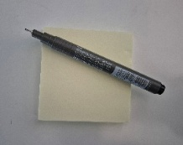
Group Activity
Work in your group and think of some RT Exercises you could use for any special population. We will go into more detail on Monday.
Work in pairs, put ideas on a post-it or interactive board and then share with the group.

Slide 45

Flexibility (ACSM, 2026)
Flexibility is the ability to move a through a joints full ROM, component of fitness and therefore included as part of any exercise prescription.
Flexibility can be improved by engaging in a number of different types of exercises that are specific to the target joint.
Various types of stretching (active and passive static, proprioceptive neuromuscular facilitation [PNF], dynamic and ballistic), foam rolling, vibration among others.

Slide 46
FITT-Flexibility Exercise Recommendation (ACSM, 2026)
Flexibility exercises are recommended to improve joint-specific ROM and to improve performance.
ROM can be improved with static, ballistic, dynamic, and/or PNF stretching. Joint-specific flexibility exercises are most effective when the muscles are warm, and pro- longed static stretching should be avoided prior to an exercise bout.
Extensive static, ballistic, and/or PNF stretching should be performed on their own, as part of a specific program to increase ROM, and not preceding any exercise activity .
Short duration (<60 seconds per muscle group) static stretching and dynamic stretches in combination with activity-specific dynamic activities (e.g.., basketball, soccer, hockey, tennis drills before the sport activity, are encouraged prior to any exercise bout and may also be used to improve performance.

Slide 47
Group Activity
Work in your group and think of some Flexibility Exercises you could use for any special population. We will go into more detail on Monday.
Work in pairs, put ideas on a post-it or interactive board and then share with the group.

Slide 48
Condition‑Specific Modifications
Components of the FITT-VP within an exercise prescription may be modified in certain chronic conditions to maximise therapeutic benefit of exercise.
On blackboard see the ACSM and Exercise is Medicine (EIM) handouts that provide specialised recommendations for numerous chronic conditions. Information from these can be used to inform condition specific modifications included in questions related to planning and implementation of your case study.
Condition‑Specific Modifications and DOSAGE will be covered in relation to special populations next session.

Slide 49

Key Factors Associated with Adherence in Exercise Programme
In a SLR of SLRs (Collado-Mateo 2021) the following key factors are associated with adherence to physical exercise in patients with chronic diseases and older adults:
Design of the Exercise Intervention
Regarding the design of the exercise program, two main key factors were identified:
(a) the individualization and the scientific basis of exercise type and
(b) the duration of the exercise programme.
Tailored exercise is necessary to achieve high levels of adherence and the duration of the exercise. Longer exercise interventions were related to lower adherence to the program.

Slide 50

Multidisciplinary Team
The presence of different professionals who conduct the exercise intervention could improve adherence.
Apart from physical exercise professional, counselling by other professionals such as psychologists, physicians, physiotherapists, nutritionists, or nurses reinforced
adherence.

Slide 51

Supervision during the Exercise Sessions
Supervision during the exercise session involves at least one professional checking how the participant is performing the prescribed exercises, which indeed enhances the quality of the execution and increases the potential benefits and reduces the possible risks of inadequate executions.

Slide 52

The Use of Technology
Some advantages have been reported, since the technology may be useful to monitor the physical activity of participants in terms of frequency duration and time, individualize the exercise prescription, provide real-time feedback, make reminders, connect professionals and patients, share the performed activities with peers, and provide instructions.

Slide 53

Enjoyment and Absence of Unpleasant Experiences
The experience of participants while doing exercise is crucial to enhance the adherence to physical exercise. Enjoyment is an immediate reward that could lead to better persistence than delayed rewards, such as health benefits in the long-term.
In the case of obesity, other unpleasant feelings can emerge:
-embarrassment with their own appearance while doing exercise, rapid exhaustion related to poor physical.
-conditioning due to physical inactivity, or lack of movement enjoyment.

Slide 54

Available Progress Information and Monitoring
Feedback on outcomes.
A comprehensive baseline evaluation is necessary to compare with future measures and provide the patient with accessible and understandable reports.

Slide 55

Self-Efficacy and Competence
Self-efficacy defined as the individuals’ belief in their own capacity to undertake a specific task and achieve the desired goal.
Competence is one of the basic psychological needs and is focused on feelings and beliefs during the action
Self-efficacy is especially relevant among chronic patients since it reflects the perceptions of the patients about the possibility of control their own life and achieve goals.

Slide 56

Participant’s Active Role
Giving the participants an active role in the exercise programmes may increase the adherence to exercise.
When the aim is to increase the adherence of patients to physical exercise in the long-term, it is crucial to give patients the tools to continue practicing exercise once the programme has ended.

Slide 57

Goal setting
Goals must be controllable by the participants.
Objectives like losing weight as fast as possible may lead to frustration and abandonment.
It is recommended to avoid unrealistic and uncontrolled expectations.
To reduce frustration and enhance motivation, goals must be SMARTS and re-evaluated

Slide 58
Other Key Factors in Adherence Exercise Programme(Collado-Mateo 2021)
Initial Exploration of Participant’s Characteristics, Barriers, and Facilitators
Participants Education, Adequate Expectations, and Knowledge about Risks and Benefits
Integration in Daily Living
Social Support and Relatedness
Communication and Feedback

Slide 59
Group Activity
Can you think of any other reasons/factors to improve adherence on an exercise programme?
Work in pairs, put ideas on a post-it or interactive board and then share with the group.

Slide 60
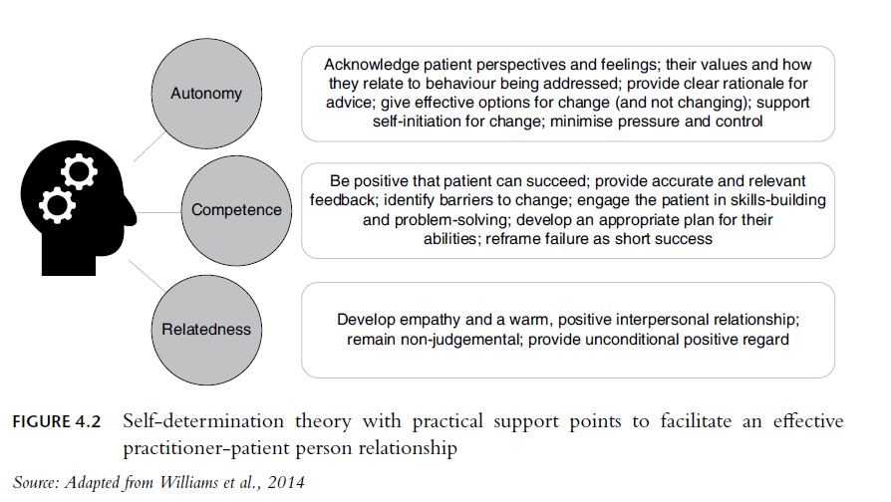
Behaviour Change & Education
The Model of Behaviour Change, which identifies the ‘readiness’ of a referred person to engage in the exercise programme or referral process.
The role of the ER practitioner/relevant health-HCP is to encourage the referred person from preparation stage (intend to take action) to progress into the action phase, in which they practice the desired behaviour, and then the maintenance phase for long-term benefits (Prochaska and Prochaska, 2014).
The ER practitioners/HCP should feel empowered to frame the consultation around the Self-Determination Theory (Swainson, Rutherford, Buckley, 2022)

Slide 61

Behaviour Change/Education-
Self-Determination Theory (ACSM, 2026)
Self-determination theory (SDT) is primarily focused on understanding motivation (Forteir et al., 2012).
The theory proposes that motivation exists on a continuum from amotivation (not motivated) to levels of extrinsic motivation (externally motivated) then to intrinsic motivation (internally motivated).

Slide 62
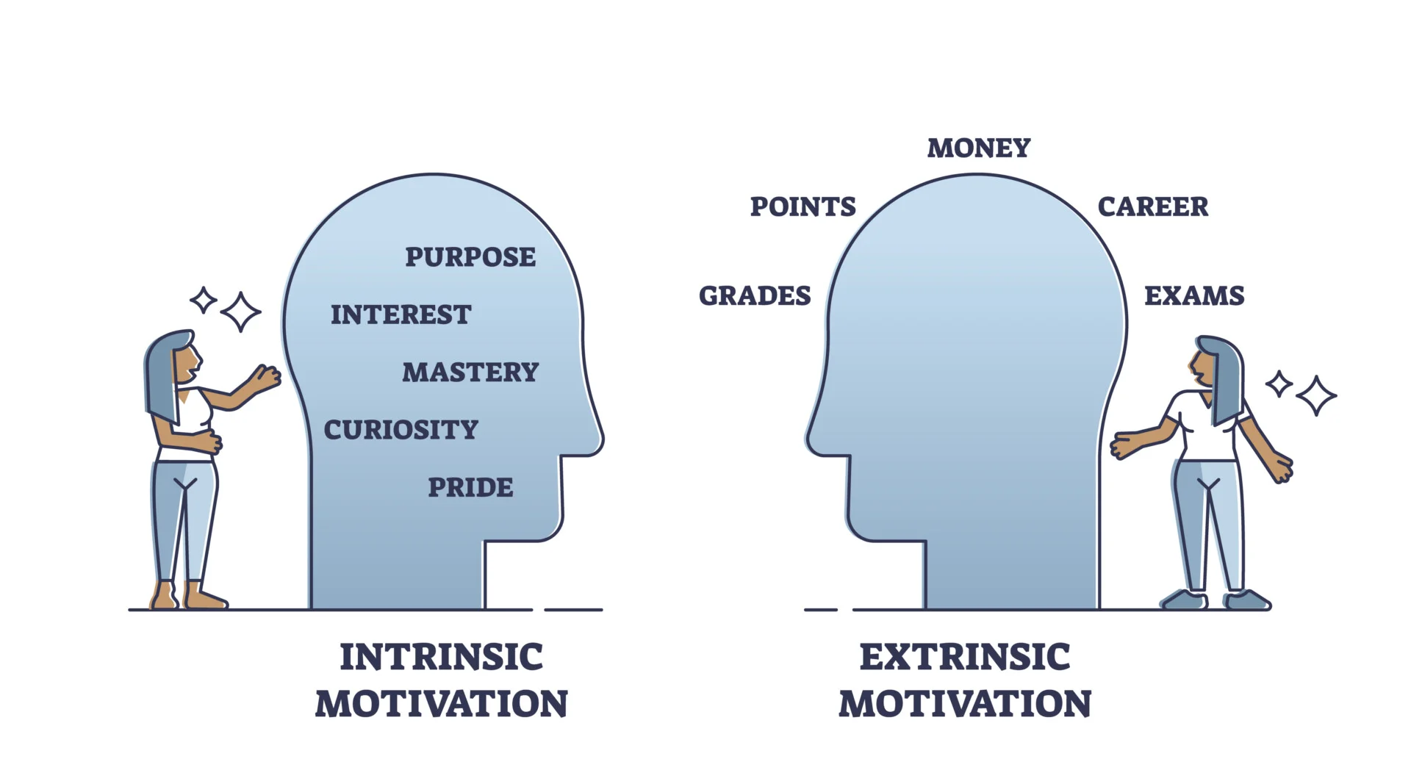
Extrinsic V Intrinsic Motivation
Extrinsic motivation refers to doing something for reasons that are external to the individual such as being physically active to make oneself more attractive to others, out of sense of obligation, to pursue rewards, or out of fear of punishment.
This is the opposite of intrinsic motivation that refers to doing something, like exercise, because it is inherently enjoyable or interesting to the individual (Forteir et al., 2012).

Slide 63
Behaviour Change & Education
ACSM emphasises behaviour‑change theories, adherence strategies, and motivational counselling to support long‑term activity.
Have some knowledge of behaviour change and adherence strategies, that may be applied to your case study exercise programme.
As an example: The ESCAPE programme for hip/knee arthritis advocates:
Educational Component: Each session begins with a discussion to educate participants on their condition, dispel myths about exercise worsening joint damage, and build self-efficacy.
Coping Strategies: The programme teaches pacing, goal setting, and flare-up management, strategies to stay active despite chronic pain.

Slide 64

Follow Up, Review & Progression
Linked to follow-up, review and progression, what would you do regarding adherence to your exercise prescription/programme? (already covered)
How often would you reassess progress by your client/patient?
How could you modify FITT‑VP variables based on progress, symptoms, and medical updates?

Slide 65
Reviewing progress and outcomes
The standard exercise referral programme is relatively short, meaning that significant improvement in clinical and/or disease-related outcomes is not always achievable or clinically significant (Pavey et al., 2011).
It should be noted that the first point of review is when the exercise practioner provides feedback on a person’s baseline results.
This is an effective approach to ensure the person knows where they are starting from and also to better inform or refine the agreed-upon goals prior to programme design.
Although many exercise referral sessions take place in a group setting, people will be more likely to adhere to a programme and engage in physical activity thereafter if the programme is composed of specifically tailored advice, as opposed to a one-size-fits-all approach.

Slide 66
Progression/Feedback (Cont`d)
1. During and after each session a. During each session, it is important that you observe the person, make notes on their movement quality and highlight any aspects of the exercises that they find difficult or can perform with ease – this information can help you determine the regression or progression of their next session.
b. At the end of each session, it is important that you provide the person with some feedback and also ask them to reflect on their session and provide you with feedback – this will help you to adapt the next session, and using a motivational interviewing–consistent conversation will ensure that you agree on these changes together and help the person feel that they have some control over the process, which will facilitate their feelings of autonomy.
2. In the interim and 12-week consultations a. Repeat each of the measures that took place during the initial consultation that will inform the reports that will be returned to the GP and other health-care professionals.
TASK: Does this only relate to PARS/ERS?

Slide 67

Any Questions?

Slide 68
References
CHEN, Y., ABDULLAH, M.F.B., ABIDIN, N.E.Z. and LI, F., 2026. Breaking boundaries: integration of sports and medicine in the community elderly service model. BMC Public Health, 26(1), pp. 366.
Global Burden of Disease Collaborative Network, Global Burden of Disease Study 2021 (GBD 2021) Results (2024, Institute for Health Metrics and Evaluation – IHME) https://vizhub.healthdata.org/gbd-results/
Mino E et al (2021) Physical activity referral scheme components: a study protocol for systematic review and meta-regression. BMJ Open.Jun 18;11(6):e049549.

Slide 69
Whitsel LP, Bantham A, Jarrin R, Sanders L, Stoutenberg M. Physical activity assessment, prescription and referral in US healthcare: How do we make this a standard of clinical practice? Prog Cardiovasc Dis. 2021 Jan-Feb;64:88-95. doi: 10.1016/j.pcad.2020.12.006. Epub 2020 Dec 28. PMID: 33383058.

